Slide 1
Module E-Standard Libraries
Library Functions

Slide 2
Library Functions
The standard C libraries include functions to perform mathematical calculations, character analysis and character manipulation.

Slide 3
Session Objectives
The standard C libraries
Standard
Time
In-Class Practice
Math
Character

Slide 4
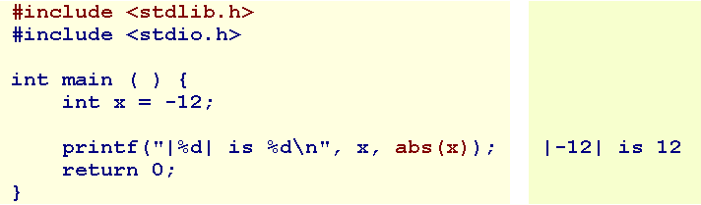
Standard-1
The prototypes for the more popular standard functions are in <stdlib.h>.
Integer Absolute Value
    int abs ( int );
    long labs ( long );

Slide 5
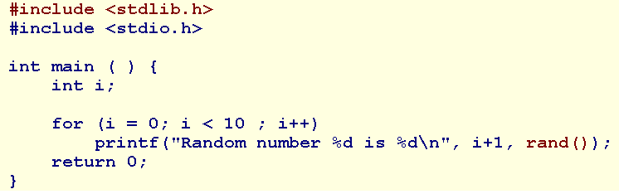
Standard-2
Random Number
rand returns a pseudo-random integer in the range 0 to RAND_MAX. RAND_MAX is implementation dependent but at least 32767.
  int rand ( void );
For example, the following program outputs the same results every run:

Slide 6
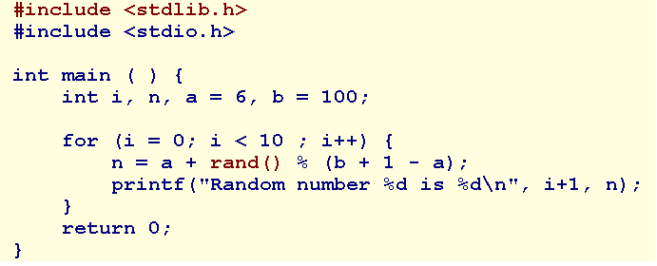
Standard-3
The following program prints 10 pseudo-random integers between 6 and 100 inclusive:

Slide 7
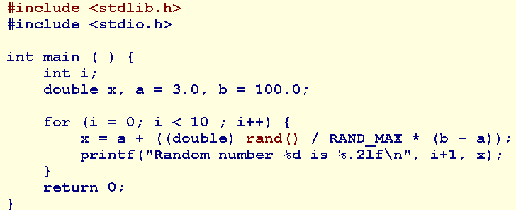
Standard-4
The following program prints 10 pseudo-random floating-point numbers between 3.0 and 100.0 inclusive:

Slide 8
Standard-5
Random Number Seed
  srand sets the seed for the random number generator.
  int srand ( unsigned int seed );
  We call srand before the first call to rand, typically at the start of our program. We use time(NULL) to generate a unique time-based seed for each new run.

Slide 9
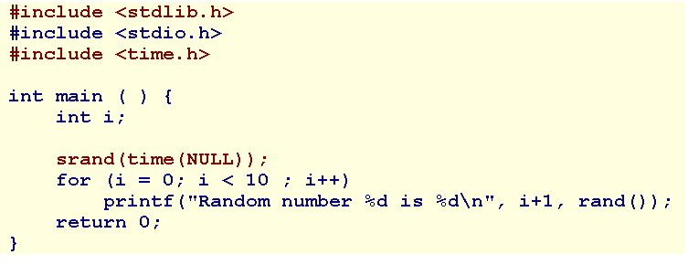
Standard-5
The following program outputs a different set of random numbers with every run:
The prototype for time is in <time.h>

Slide 10
Time-1
The prototypes for the time library functions are in <time.h>.
time returns the current calendar time. The prototype is
  time_t time ( time_t *tptr );
  time_t is a type that it is sufficiently large to hold time values (for example, unsigned long).
  time also assigns the current calendar time to *tptr, if tptr is not NULL.
  If an error occurs, time returns the value (time_t)(-1).

Slide 11
time-2
difftime
difftime returns the difference in seconds between two calendar time arguments.
  double difftime ( time_t, time_t );
  time_t is a type that it is sufficiently large to hold time values (for example, unsigned long).

Slide 12
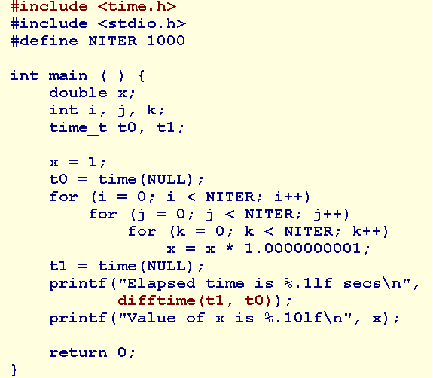
time-3

Slide 13
clock-1
clock returns the approximate process time. The prototype is
  clock_t clock ( void );
clock_t is a type that holds time values (for example, unsigned long). We divide the time value by CLOCKS_PER_SEC to obtain the process time in seconds.

Slide 14
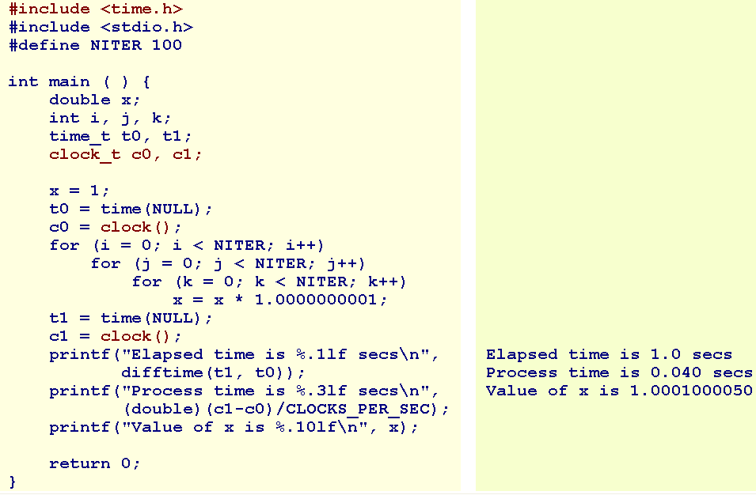
clock-2

Slide 15
In-Class Practice
Design and code a program named coinToss.c that
  prompts the user for the number of times to toss a coin,
  accepts a positive value as the number of times,
  simulates the coin tosses for the requested number of times, and
  reports the percentage of head results and the percentge of tail results for the coin tosses.

Slide 16
Math-1
The prototypes for the math functions are in <math.h>.

Slide 17
Math-2
Floating-Point Absolute Value
fabs, fabsf returns the absolute value of the floating-point value received. Their prototypes are
  double fabs ( double );
  float fabsf ( float );

Slide 18
Math-3
Floor
floor, floorf return the largest integer value not greater than the value received. Their prototypes are
  double floor ( double );
  float floorf ( float );
For example, floor(16.3) has a value of 16.0.

Slide 19
Math-4
Ceiling
ceil, ceilf return the smallest integer value not less than the value received. Their prototypes are
  double ceil ( double );
  float ceilf ( float );
For example, ceil(16.3) has a value of 17.0.

Slide 20
Math-5
Rounding
round, roundf return the integer value closest to the value received. Their prototypes are
  double round ( double );
  float roundf ( float );
For example, round(16.3) has a value of 16.0, while round(-16.3) has a value of -16.0.

Slide 21
Math-6
Truncating
trunc, truncf, truncl return the integer component of the value received. Their prototypes are
  double trunc ( double );
  float truncf ( float );
  long double truncl ( long double );
For example, trunc(16.7) has a value of 16.0, while round(-16.7) has a value of -16.0.

Slide 22
Math-7
Square Root
sqrt, sqrtf, sqrtl return the square root of the floating-point value received. Their prototypes are
  double sqrt ( double );
  float sqrtf ( float );
  long double sqrtl ( long double );
For example, sqrt(16.0) has a value of 4.0.

Slide 23
Math-8
Powers
pow, powf, powl return the result of the first floating-point value received raised to the power of the second floating-point value. Their prototypes are
  double pow ( double base, double exponent );
  float powf ( float base, float exponent );
  long double powl ( long double base, long double exponent );

Slide 24
Math-9
Logarithms
log, logf, logl return the natural logarithm of the floating-point value received. Their prototypes are
  double log ( double );
  float logf ( float );
  long double logl ( long double );
For example, log(2.718281828459045) has a value of 1.0.

Slide 25
Math-10
Powers of e
exp, expf, expl return the natural anti-logarithm of the floating-point value received. Their prototypes are
  double exp ( double );
  float expf ( float );
  long double expl ( long double );
For example, exp(1.0) has a value of 2.718281828459045

Slide 26
Character-1
The prototypes for character analysis and character manipulation functions are in <ctype.h>.
In checking for a true value, we check that the value is not false: that is, value != 0, rather than assume that true is represented by unity

Slide 27
Character-2
int islower ( int );
int isupper ( int );
int tolower ( int );
int toupper ( int );
int isalpha ( int );
int isdigit ( int );
int isspace ( int ); (Whitespace characters are ' ', '\t', '\n', '\v', and '\f'. )
int isblank ( int ); (space or tab )

Slide 28
Summary
The standard C libraries
Standard
Time
Math
Character
Q&A

Slide 29
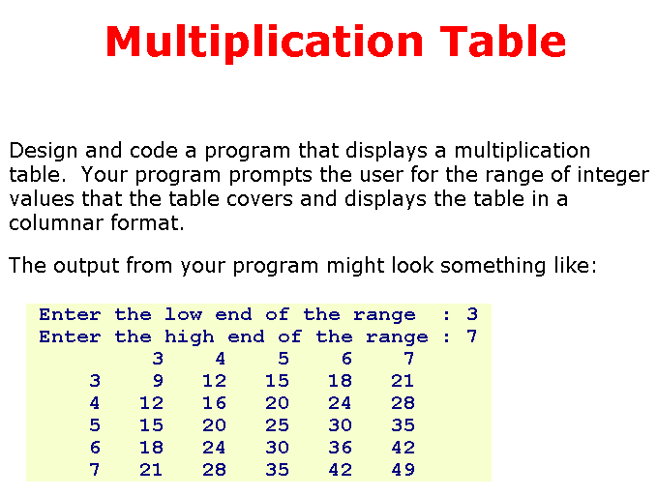
Practice

